Slide 1
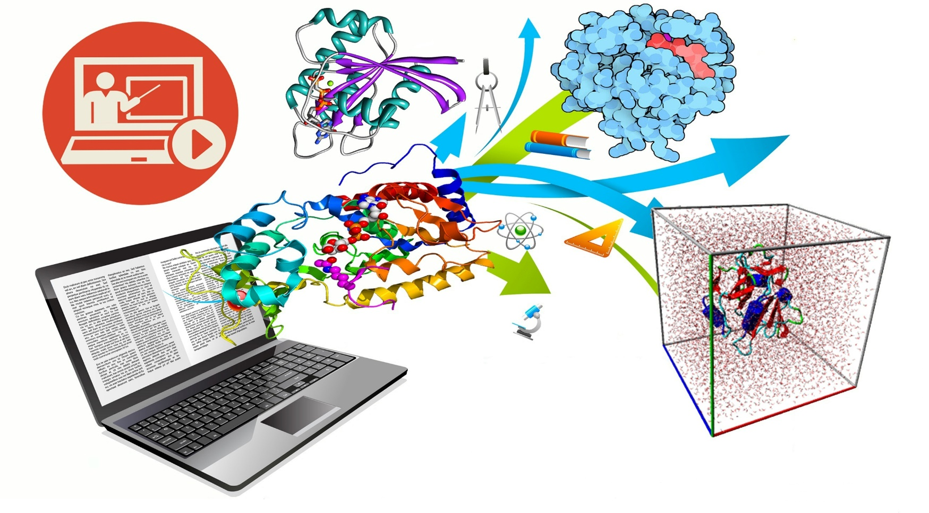
Int@E
Innovative technologies and education

Slide 2
Int@E
German firm which provides innovative technologies in education since 2015
Organization of vocational trainings
Knowledge Management
Mobile learning
E-learning
Innovations in medical training
Software trainings
1

Slide 3
Int@E
Collaborative research and innovation
Quality assessments
Organization of analysis in education
Development of education models
Researches in education theory
2

Slide 4
Int@E
Employees with experience in participation in several EU Programs
Tempus Projects
Erasmus+ Projects
ModeHEd
VTC
OPATEL
MAGNET (Workshop October 2017)
4

Slide 5
Int@E
Role in the Project MediTec
Transfer of experience of trainings to partners
Sharing experience on innovative training in medical technologies
Enriching information base of partner universities
with data from EU database
Monitoring of the activities, conducted by the PC partners
Quality control (training process + training materials + quality report)
Evaluation of the training courses and training program
5

Slide 6
Int@E
Role in the Project MediTec
Promotion of the project at scientific conferences and international meetings
Assistance in the development of project newsletters
Strengthening the network between partners and other non-project HEI’s
Responsibility for dissemination of results within the project – WP5
6

Slide 7
Int@E
Contact:
www.intate.de
Juman Ebdah
jum.ebdah@gmail.com
6

Slide 8
Int@E
Thank you for your Attention!

